Slide 1
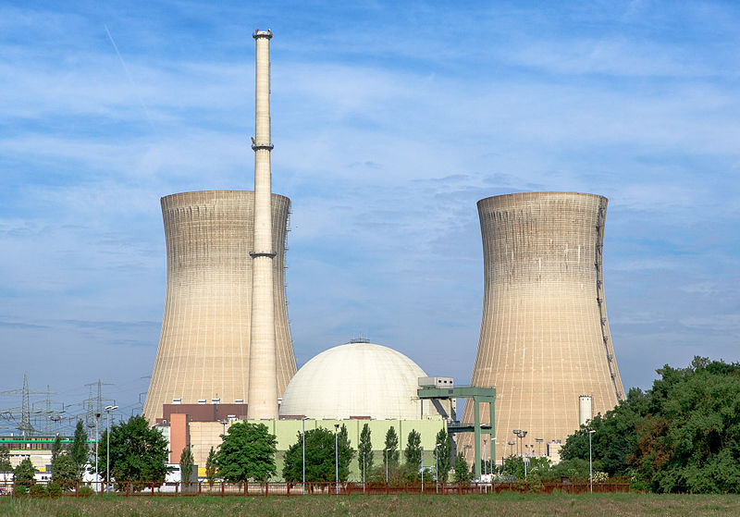
Nuclear Power Plant:
A Burden or
Blessing
NAME: ID:
ZULFIKAR ZISAN 19-39387-1
WASEK AL AZAD 19-39381-1
SHADMAN SAKIB 19-39373-1
MD. IMTIAZ HABIB 19-39389-1

Slide 2
Topics to be covered:
What is a Nuclear power plant?
Is it better for the world?
What are some advantages of it?
What are the disadvantages of this system?
Why do we think it’s inappropriate for us?
Should we avoid this system?

Slide 3
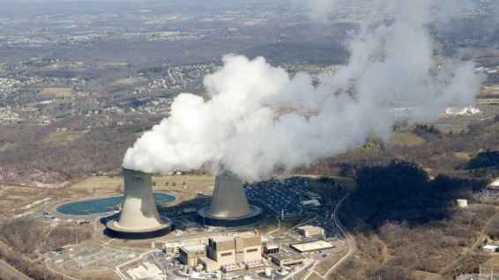
What is a nuclear power plant:
A nuclear power plant or nuclear power station is a thermal power station and a source of energy.

Slide 4
Advantages of nuclear power plant:
Produces no polluting gases.
Least contribution to global warming
Sustainable and long term project.
It fulfills electricity demand.

Slide 5
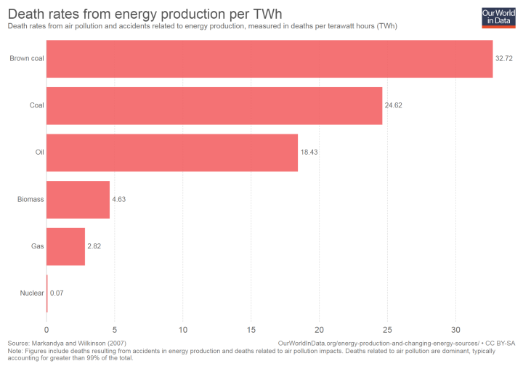
Advantages of nuclear power plant:

Slide 6

Advantages Over Alternatives

Slide 7
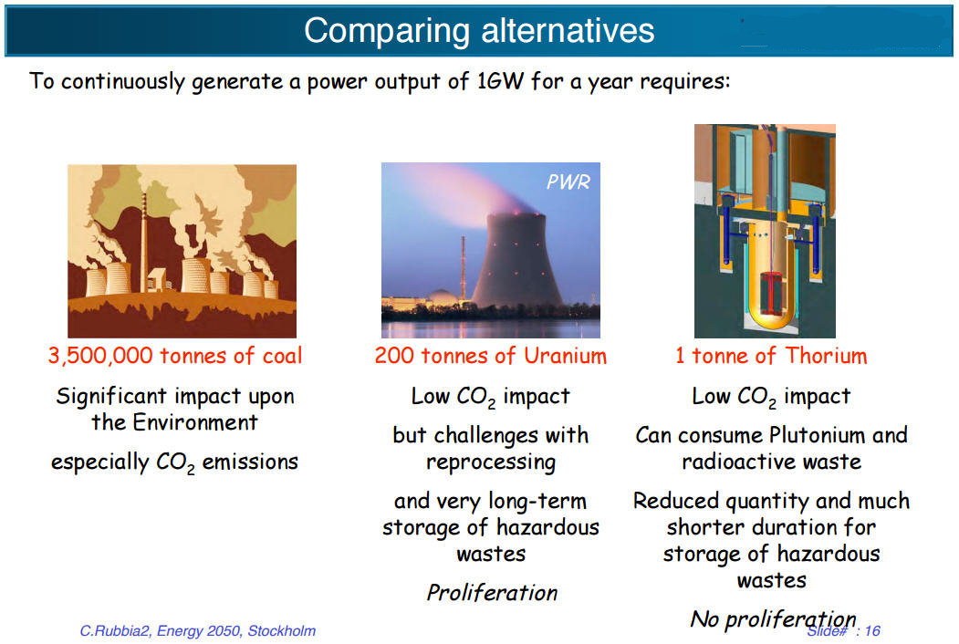
Energy per Unit

Slide 8
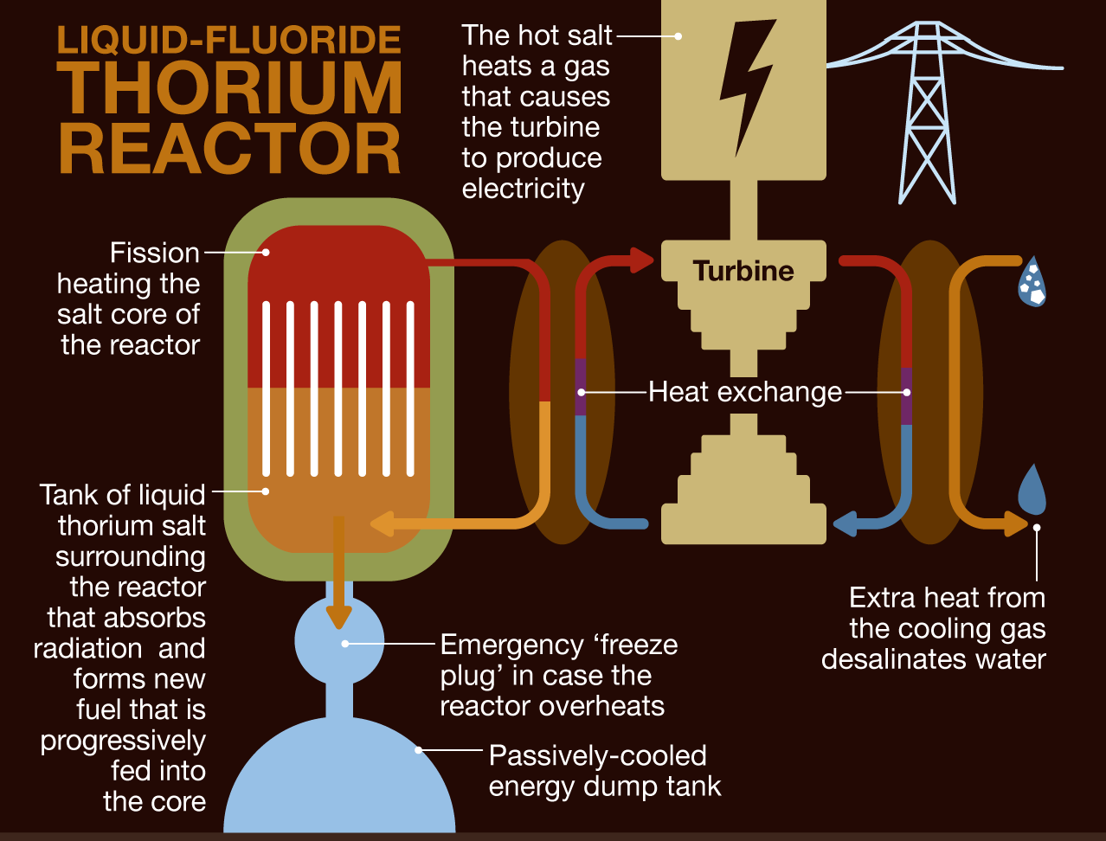
New Technologies

Slide 9
Disadvantages of nuclear power plant:
Huge amounts of raw materials are used.
Waste is radioactive.
Safe disposal is difficult and very expensive
Thermal pollution from wastewater affects marine life.
Nuclear leaks.
Shutdown reactor.

Slide 10
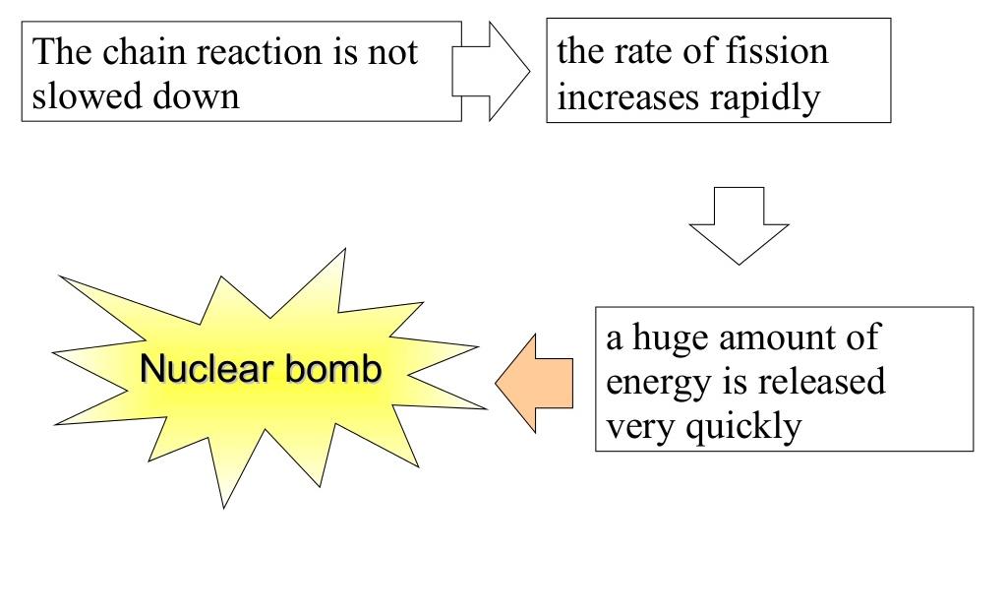
Uncontrolled nuclear reaction:

Slide 11
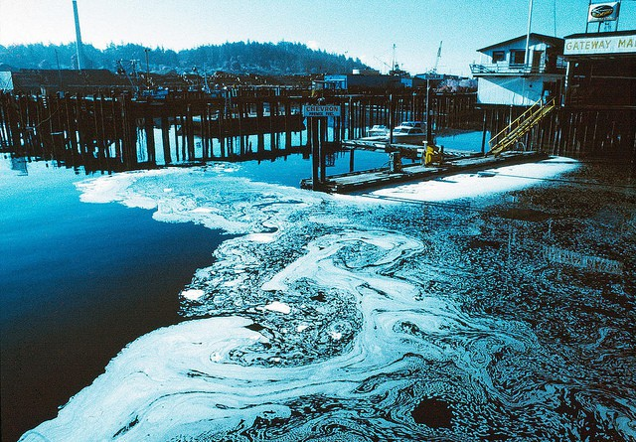
Thermal pollution:

Slide 12
Why we think it is inappropriate for us:
Developed countries are destroying their nuclear projects.
We have experienced so many incidents before.
Maintenance is expensive.
As a developing country Bangladesh is not suitable for such project.

Slide 13
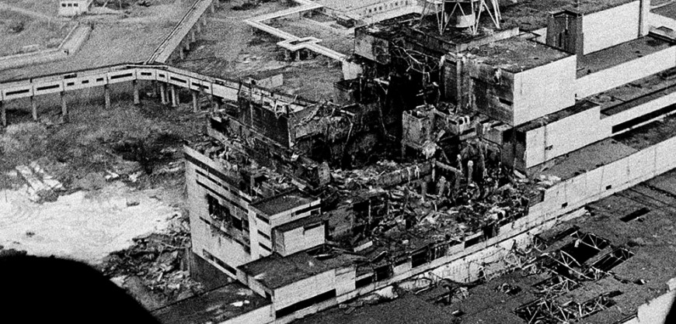
Chernobyl Disaster 1986

Slide 14
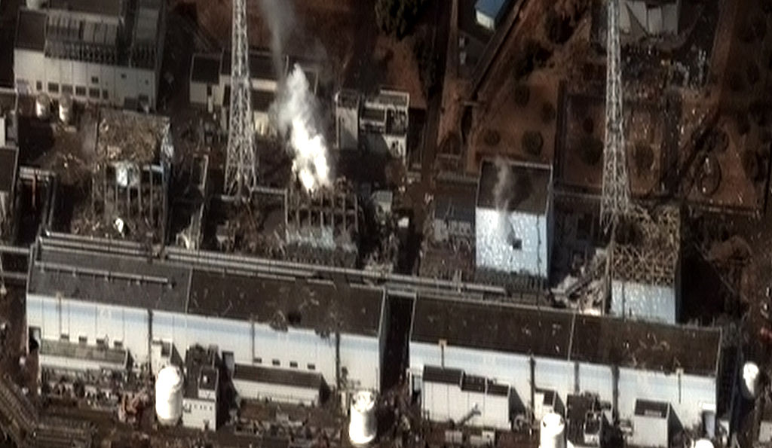
Fukushima Daiichi Disaster 2011

Slide 15
Thank You!

